Slide 1
Azure Container Registry
Steve Lasker
Program Manager
Azure Developer Experiences
@SteveLasker

Slide 2
Why: Azure Container Registry
Keeping your Images Network-Close
Deployed to your targets within the same data center
No ingress/egress fees, latency with better reliability
Keep Your Images Private
Stored in Azure, secured at rest, secured with AAD with the rest of your Azure resources
Geo Replicated Across the Globe
Manage global deployments as one resource, keeping the network-close
Azure Active Directory Integration
Manage registry access using AAD (individual and service auth)
Familiar Open Source CLIs
docker login, pull, push
Secure & Patched
OS & Framework patching coming with ACR Builder

Slide 3
Containers as a common deployment currency
Batch
ACI
AKS
App Service
Service Fabric
Azure Container Registry
Azure clients: CLI, PS, Portal, SDK
Developer tools: VS, VS Code, VSTS

Slide 4
Azure Compute Platform
Web/ mobile
Functions
Logic Apps
Clusterless
Orchestration
Easy/Single containers
VM Auto Scale
Customization
Kubernetes apps
SF apps
App Service
Managed Kubernetes
Azure Service Fabric
Marketplace
Azure Batch
Cloud Services
OpenShift, Cloud Foundry, DCOS, Docker EE
Azure Container Instances
Azure Container Registry
VMs and Scale sets
Azure Resource Manager

Slide 5
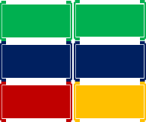
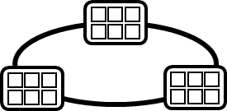


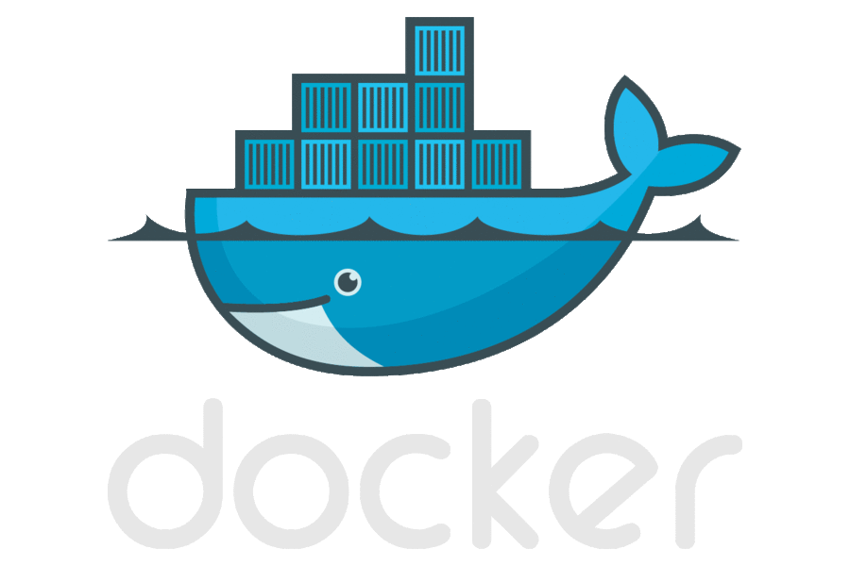
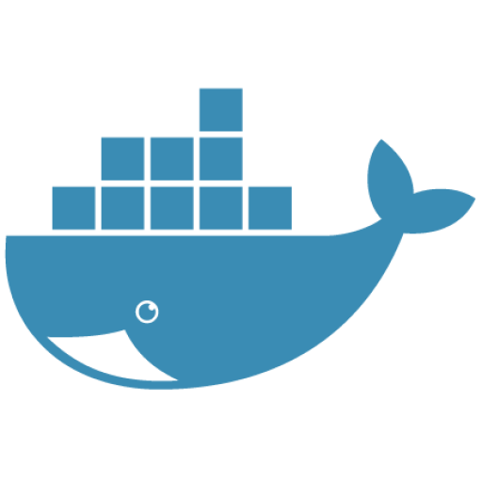

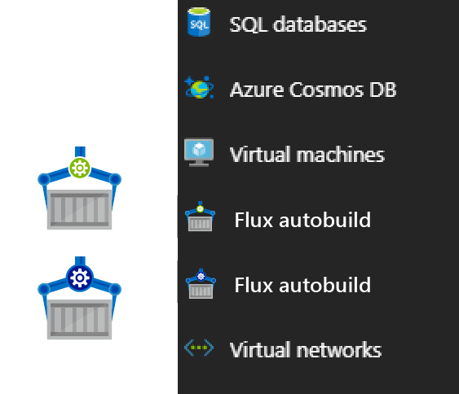

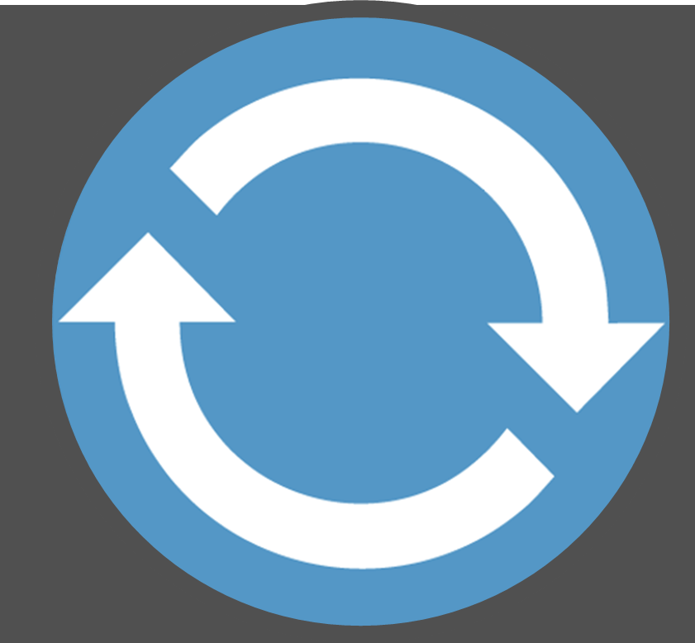
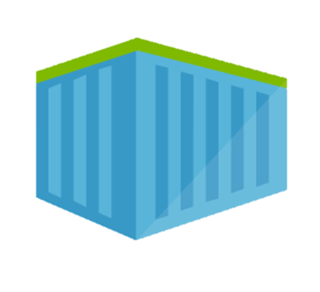
Container DevOps Workflow
Container Service
OS & Framework Patching
What happens when developers stop making code changes?
Run, Manage
Service Fabric
Source Code Control
(SCC)
Build/CI,
Integrate,
Test
CD, Deploy
App Services
Production
environments
coming soon
Base Image Index
…
Docker Hub
Azure Container _Builder*
Azure Container Registry
…
Inner-Loop
…
Run
Monitor and Diagnose
Code
Validate
Debug

Slide 6
Authenticating with ACR
Using familiar docker CLIs
Individual Identity, using Azure Active Directory Identity
Server/Headless identity using AAD Service Principals
Provision Service Principals, with scoped access control
Contributor – Push/Pull
Reader – Pull Only
Eg: assign the Kubernetes created principal, desired access to each registry
az login
az acr login --name [registryName]
docker push / pull

Slide 7
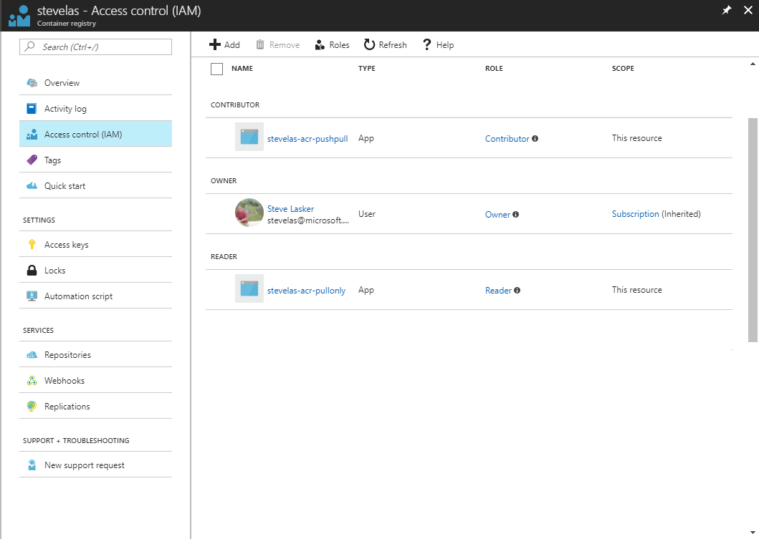
Owner – Push, Pull, ARM Resource Management eg: IAM configuration
Contributor – Push, Pull
Reader – Pull Only

Slide 8
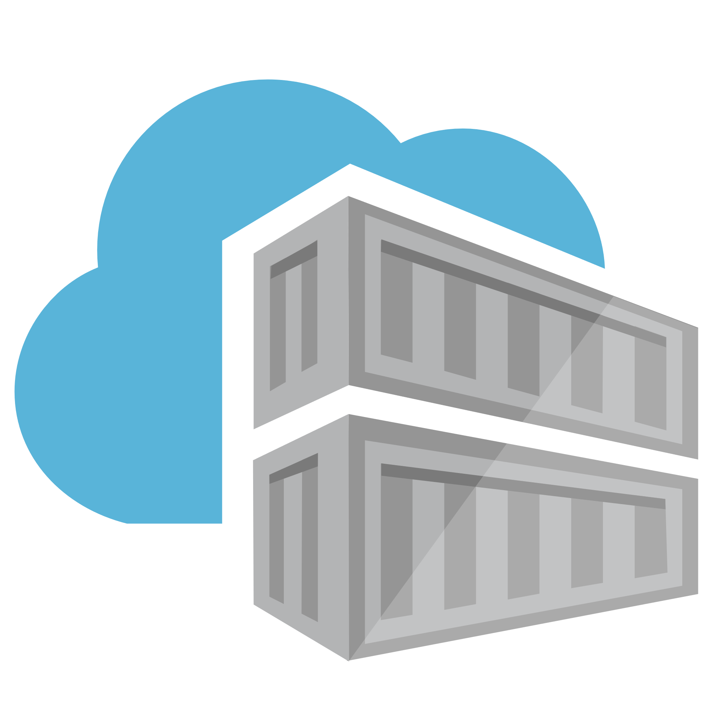

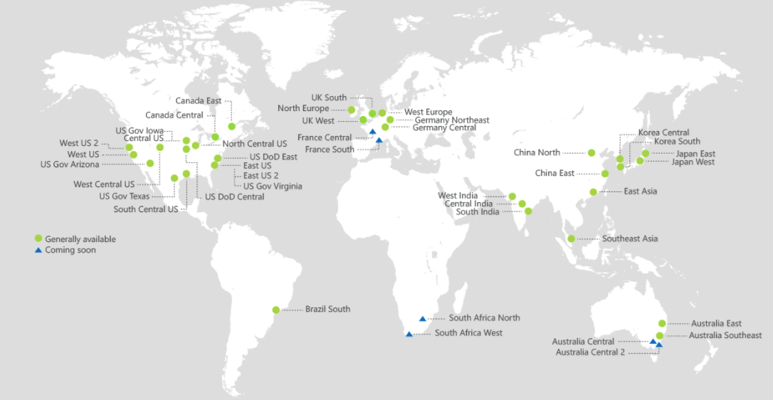
ACR Geo-replication
Mange your global/local deployments as one resource
http://aka.ms/acr/geo-replication

Slide 9
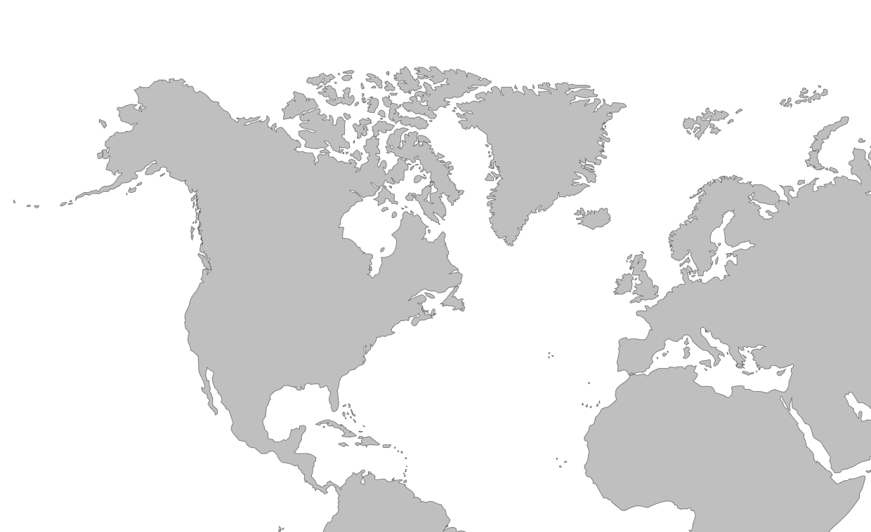
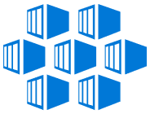
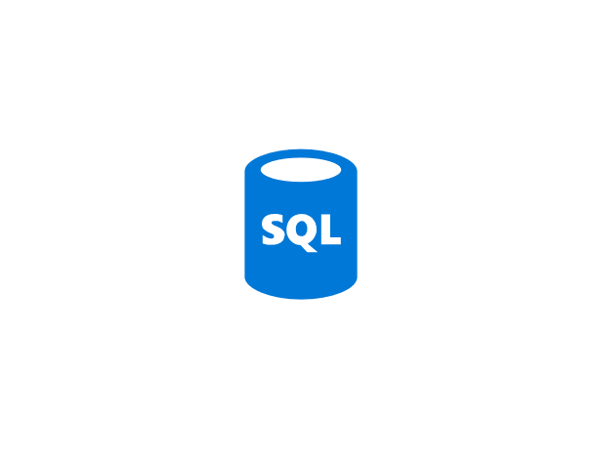

Push Built Images
docker push contosowestus.azurecr.io/web:1234
docker push contosowesteurope.azurecr.io/web:1234
Nodes Pull Images
docker pull contosowestus.azurecr.io/web:1234
docker pull contosowesteurope.azurecr.io/web:1234
Pulls are local, network-close, fast, reliable
Pulls are remote, across the public internet, slower, less reliable
Have network egress fees
Pulls are remote, across the public internet, slower, less reliable
Have network egress fees
West Europe
Canada Central
West US
East US
Developers must push images to n registries, requiring separate management and configuration

Slide 10

Push Built Images
docker push contoso.azurecr.io/web:1234
ACR Syncs Image Blobs
Regional Web Hooks fire for local deployments
Nodes Pull Images
docker pull contoso.azurecr.io/web:1234
Geo-replicate a single registry
All regions have a local replica
Geo-replicate a single registry
All regions have a local replica
West Europe
Canada Central
West US
East US
Each registry is pulling from a local, network close, reliable registry

Slide 11
Azure Container Registry
Providing a single registry across the globe
aka.ms/ACR
aka.ms/ACR/Docs
aka.ms/ACR/Geo-replication
aka.ms/ACR/Roadmap

Slide 12
ACR Roadmap: H1 2018
Feature | Description
Existing VNET | Add ACR to an existing VNET
ACR Build | OS & Framework Patching
Additional Clouds | China, US Gov, Germany
Event Grid Integration | Base Image Updates, ACR Image Push, Delete
Overage Meters | Enabling customers that have large storage
Auto-Purge | Maintaining a pruned registry
Trusted Registries | Support Signed Images
ISO, HIPPA, HITRUST, PCI Compliance | Assure ACR adheres to the strictest compliance standards
Image Telemetry | Image pull statistics
Image Quarantine | Limiting access to newly pushed images, until vulnerability scanning completed
CDN Support | Additional performance to Premium Registries
http://aka.ms/acr/roadmap

Slide 13


Azure Container Registry
Network-Close, Fast, Reliable, Secured w/AAD, Image Management
Tiered SKUs providing low cost prototyping to hyper scale
GA managed registries October ‘17
52 million push/pull operations per month
deployed 11gb images to 1,000 nodes in 10 mins-11TB throughput
Geo-replication, enabling single management across all data centers ^{(Preview)}
aka.ms/ACR/Roadmap
Notes:
Azure AD for individual and service identity

Slide 14
ACR Tiered SKUs
Basic – Low cost entry point for developer POCs
Standard – Majority of dev & production scenarios with most common scale
Premium – HyperScale for larger, global deployments
Feature | Basic | Standard | Premium
Storage | 10 GiB | 100 GiB | 500 GiB
ReadOps per minute^{1, 2} | 1k | 300k | 10,000k
WriteOps per minute^{1, 3} | 100 | 500 | 2k
Download bandwidth MBps¹ | 30 | 60 | 100
Upload bandwidth MBps¹ | 10 | 20 | 50
Webhooks | 2 | 10 | 100
Geo-replication | N/A | N/A | Supported (preview)
SKUs http://aka.ms/acr/skus
¹ ReadOps, WriteOps, and Bandwidth are minimum estimates. ACR strives to improve performance as usage requires.+
² docker pull translates to multiple read operations based on the number of layers in the image, plus the manifest retrieval.
³ docker push translates to multiple write operations, based on the number of layers that must be pushed. A docker push includes ReadOps to retrieve a manifest for an existing image.

Slide 15
Authenticating with ACR
Using familiar docker CLIs
Individual Identity, using Azure Active Directory Identity
Server/Headless identity using AAD Service Principals
Provision Service Principals, with scoped access control
Contributor – Push/Pull
Reader – Pull Only
Eg: assign the Kubernetes created principal, desired access to each registry
az login
az acr login --name [registryName]
docker push / pull

Slide 16
Owner – Push, Pull, ARM Resource Management eg: IAM configuration
Contributor – Push, Pull
Reader – Pull Only

Slide 17
ACR Geo-replication
Mange your global/local deployments as one resource
http://aka.ms/acr/geo-replication

Slide 18
Push Built Images
docker push contosowestus.azurecr.io/web:1234
docker push contosowesteurope.azurecr.io/web:1234
Nodes Pull Images
docker pull contosowestus.azurecr.io/web:1234
docker pull contosowesteurope.azurecr.io/web:1234
Pulls are local, network-close, fast, reliable
Pulls are remote, across the public internet, slower, less reliable
Have network egress fees
Pulls are remote, across the public internet, slower, less reliable
Have network egress fees
West Europe
Canada Central
West US
East US
Developers must push images to n registries, requiring separate management and configuration

Slide 19
Push Built Images
docker push contoso.azurecr.io/web:1234
ACR Syncs Image Blobs
Regional Web Hooks fire for local deployments
Nodes Pull Images
docker pull contoso.azurecr.io/web:1234
Geo-replicate a single registry
All regions have a local replica
Geo-replicate a single registry
All regions have a local replica
West Europe
Canada Central
West US
East US
Each registry is pulling from a local, network close, reliable registry

Slide 20
Geo-replication Q&A
Regions are multi-master
Each Docker push creates new image layers, eliminating normal update conflicts
Updating an existing tag; last writer wins, and will be eventually consistent across all regions
Push can be done to any region, replicated to others
RBAC is shared across all regions
Each region has geo-redundant storage

Slide 21
Geo-replication Q&A
Each region billed as a premium registry
Max storage and throughput, metered per registry
Can be configured through the portal, or az CLI
Original region is the primary region, which currently can’t be removed
Looking to integrate with Azure Event Grid for dead letter queue and retry notifications

Slide 22
Registry Routing
Uses Azure Traffic Manager for local routing
Regional Webhooks for local arrival notification
Replicas can be added/removed at any time
Traffic manager dynamically updated
Working from a remote location for a while, enable a replica, remove when complete

Slide 23
Replication over CDN
Geo-replication is multi-master
Push can be done to any region, replicated to others
Geo-replication: opt into replicated regions
CDN based on a single master
CDN costly
Cost comparison…

Slide 24
Demo
aka.ms/acr/geo-replication

Slide 25
Azure Container Registry
Providing a single registry across the globe
aka.ms/ACR
aka.ms/ACR/Docs
aka.ms/ACR/Geo-replication
aka.ms/ACR/Roadmap

Slide 26


Azure Container Registry Partners
Vulnerability Scanning

Slide 27
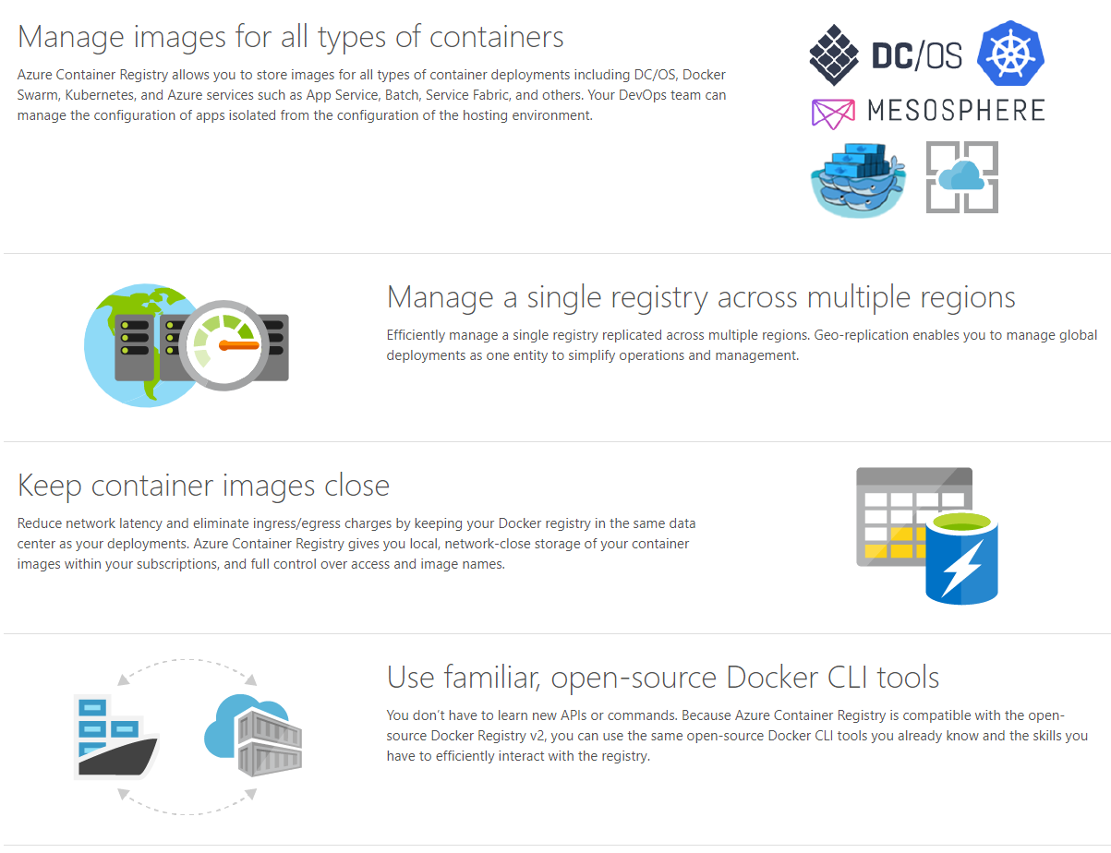
Get Started Today
aka.ms/acr

